Slide 1
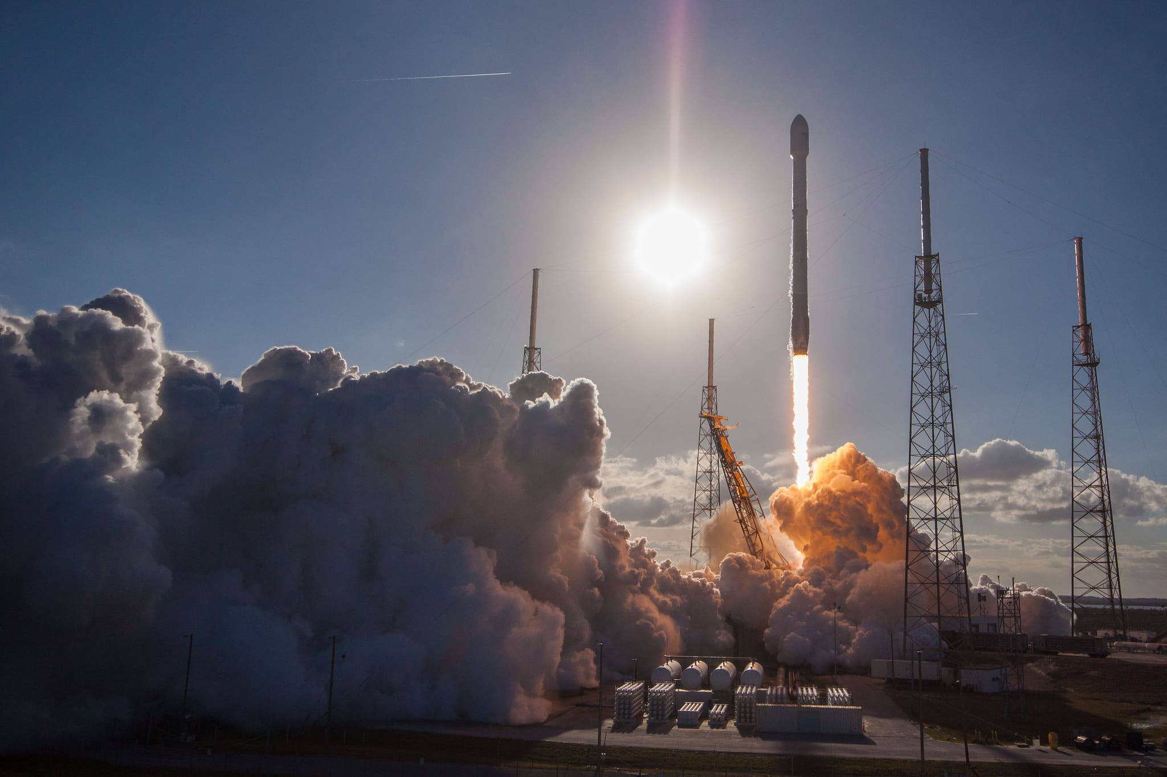

data science capstone project: Space Y
Moaz Agha
12-14-2022

Slide 2
Executive Summary
Introduction
Methodology
Results
Conclusion
Appendix
Outline

Slide 3
Executive Summary
Data collection via API, SQL, and Web Scraping
Exploratory data analysis and interactive data visualization were produced
Reliable Machine Learning models with 83% success rate were generated as predictive algorithms

Slide 4
Introduction
The competitor SpaceX launches with a cost of $62 million
Other providers cost upward of $165 million each
Much of the savings is because SpaceX can reuse the first stage
Problem Statements:
Determining if the first stage would land, thus, estimating the cost of each launch for Space Y
The effect of each relationship, of SpaceX rocket launches, on the outcome
What could we learn from our competitors?

Slide 5

Methodology

Slide 6
Methodology
Data Collection
Using Rest API and web scraping
Data wrangling
Data cleaning of nulls values and irrelevant columns
One hot encoding data fields for Machine Learning
Exploratory data analysis using visualization and SQL
Interactive visual analytics using Folium and Plotly Dash
Predictive analysis using classification models

Slide 7
Data collection
SpaceX launch data was obtained through the SpaceX REST API
The API URL -
The URL gives us data about the launches including:
The rocket used, payload, launch specifications, landing specifications and outcomes
Another popular method of collecting data is web scraping:
Wiki page Included some HTML tables containing info about Flacon 9 launch records
Python BeautifulSoup Package was used to acquire the tables

Slide 8
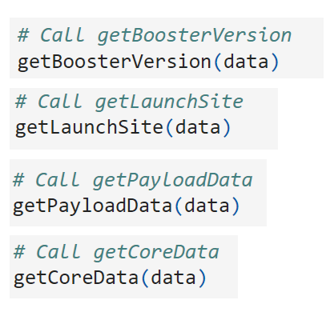
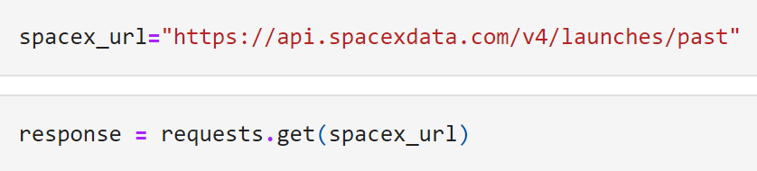
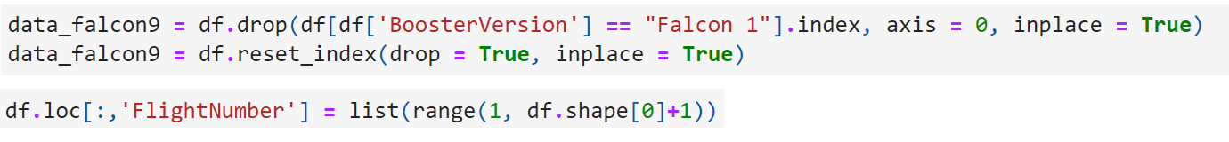
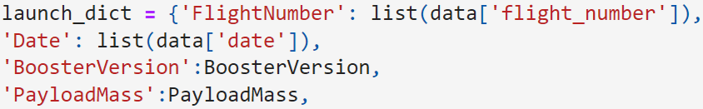
Data collection – Spacex API
Getting response from API
Converting Response to a .json file
Apply custom functions to clean data
Assign list to dictionary then create dataframe
Filter dataframe and export to a .csv file
Link: Data Collection via API Notebook on GitHub

Slide 9
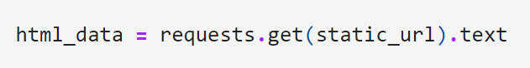
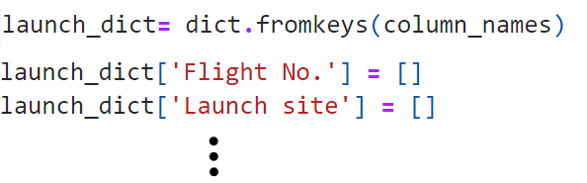
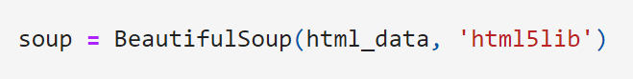
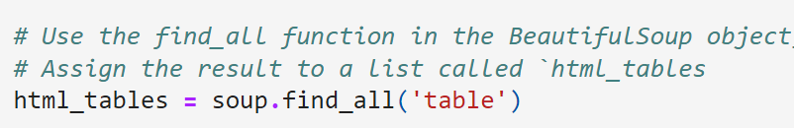
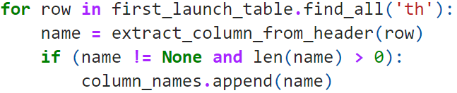
Data collection – Web Scraping
1. Getting response from HTML
2. Creating BeautifulSoup Object
3. Finding tables
4. Calling columns names
5.Creating dictionary
6. Appending data to keys
7. Converting dictionary to dataframe
8. Exporting dataframe to .csv file
Link: Data Collection with Web Scraping Notebook on GitHub

Slide 10
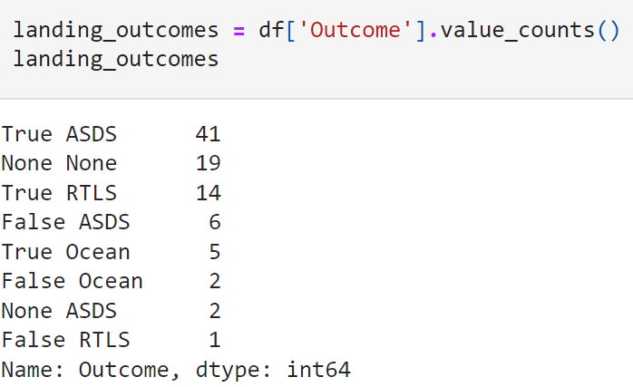
Data wrangling
Performed exploratory data analysis to find patterns and determine the label for training supervised models
There were 8 types of outcomes. 3 were labelled successful (1s) , 5 were labelled as bad outcome (0s)
Import data from .csv file
Calculate the number of launches at each site
Calculate number and occurrence of each orbit
Calculate the occurrence of each landing outcome per orbit type
Create a landing outcome label from outcome column
Handle null values
Convert class (Success of landing) to 1s (good outcome) and 0s (bad)
Link: Data Wrangling Notebook on GitHub

Slide 11
EDA with data visualization
Categorical Plot
2 Plots
1. Launch outcome based on payload mass vs. flight number
Scatter Plot
3 Plots
1. Launch outcome based on launch site vs. payload mass
Bar Chart
1 Plot
Launch success yearly trend
Line Plot
1 Chart
Relationship between launch success rate of each orbit
2. Launch outcome based on launch site vs. flight number
2. Launch outcome based on payload mass vs. orbit type
3. Launch outcome based on flight number vs. orbit type
Link: EDA with Data Visualization Notebook on GitHub

Slide 12
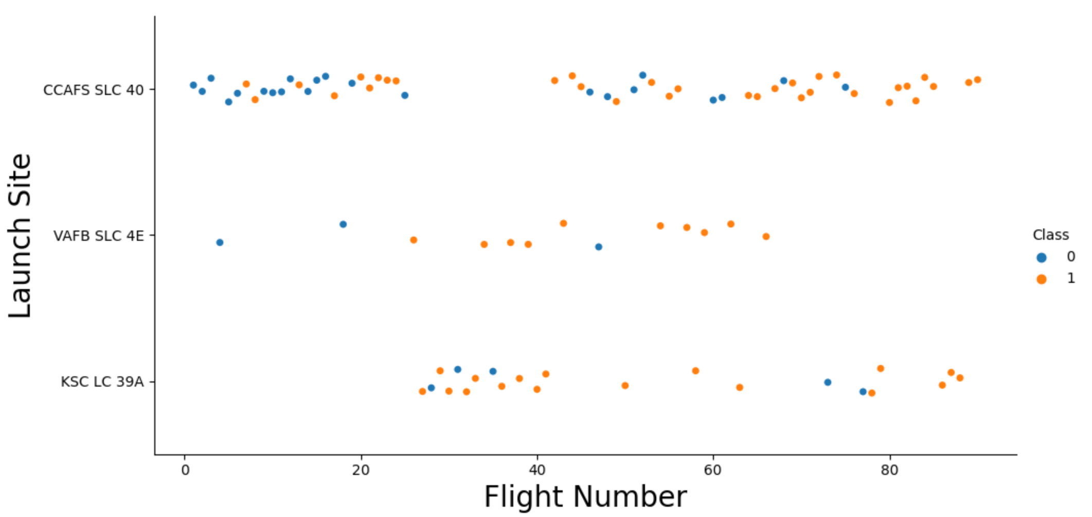
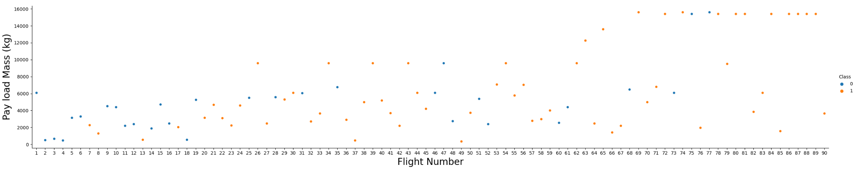
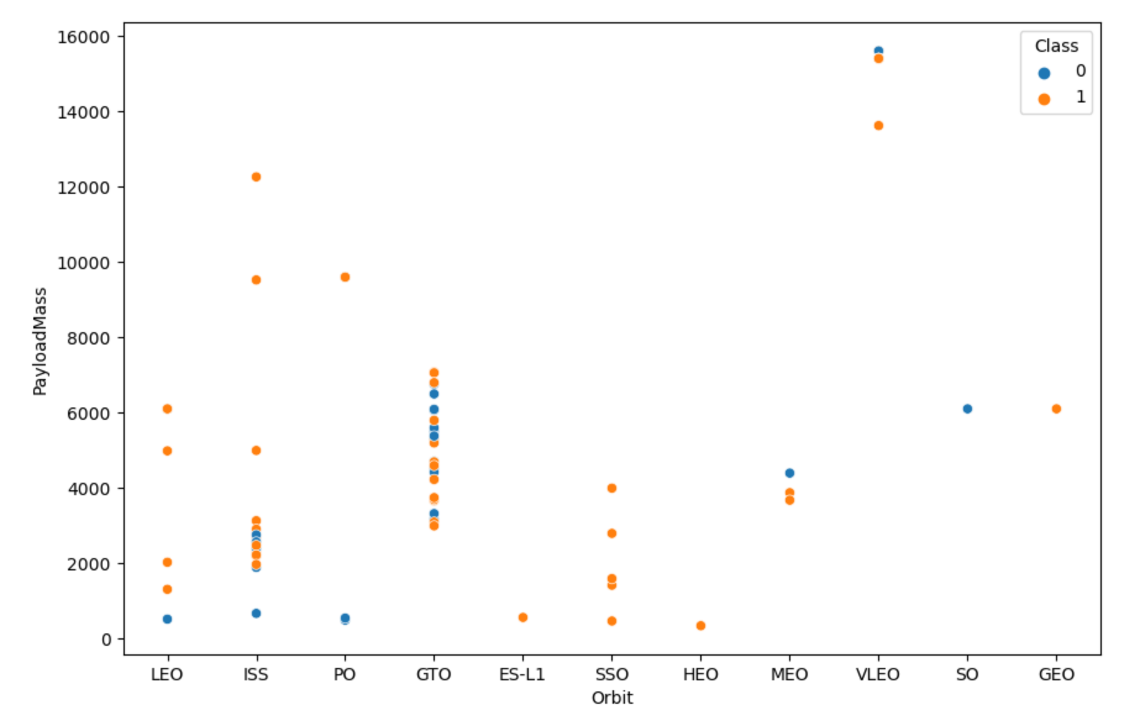
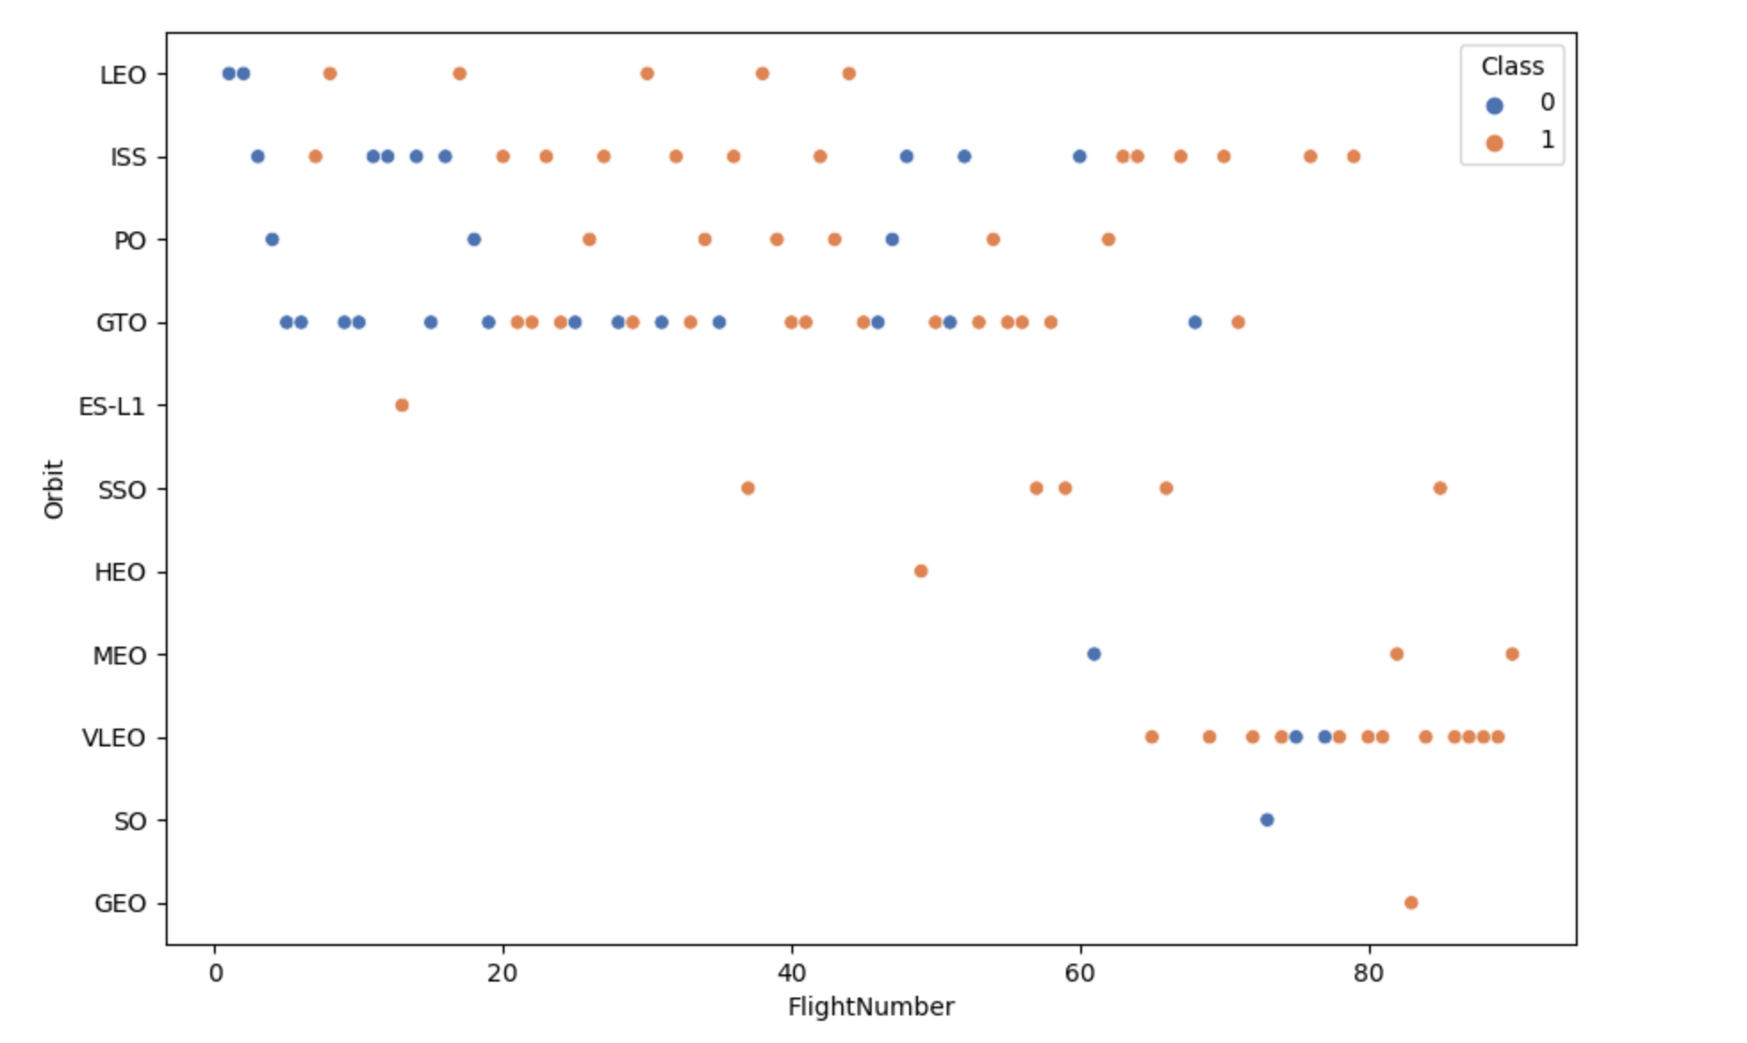
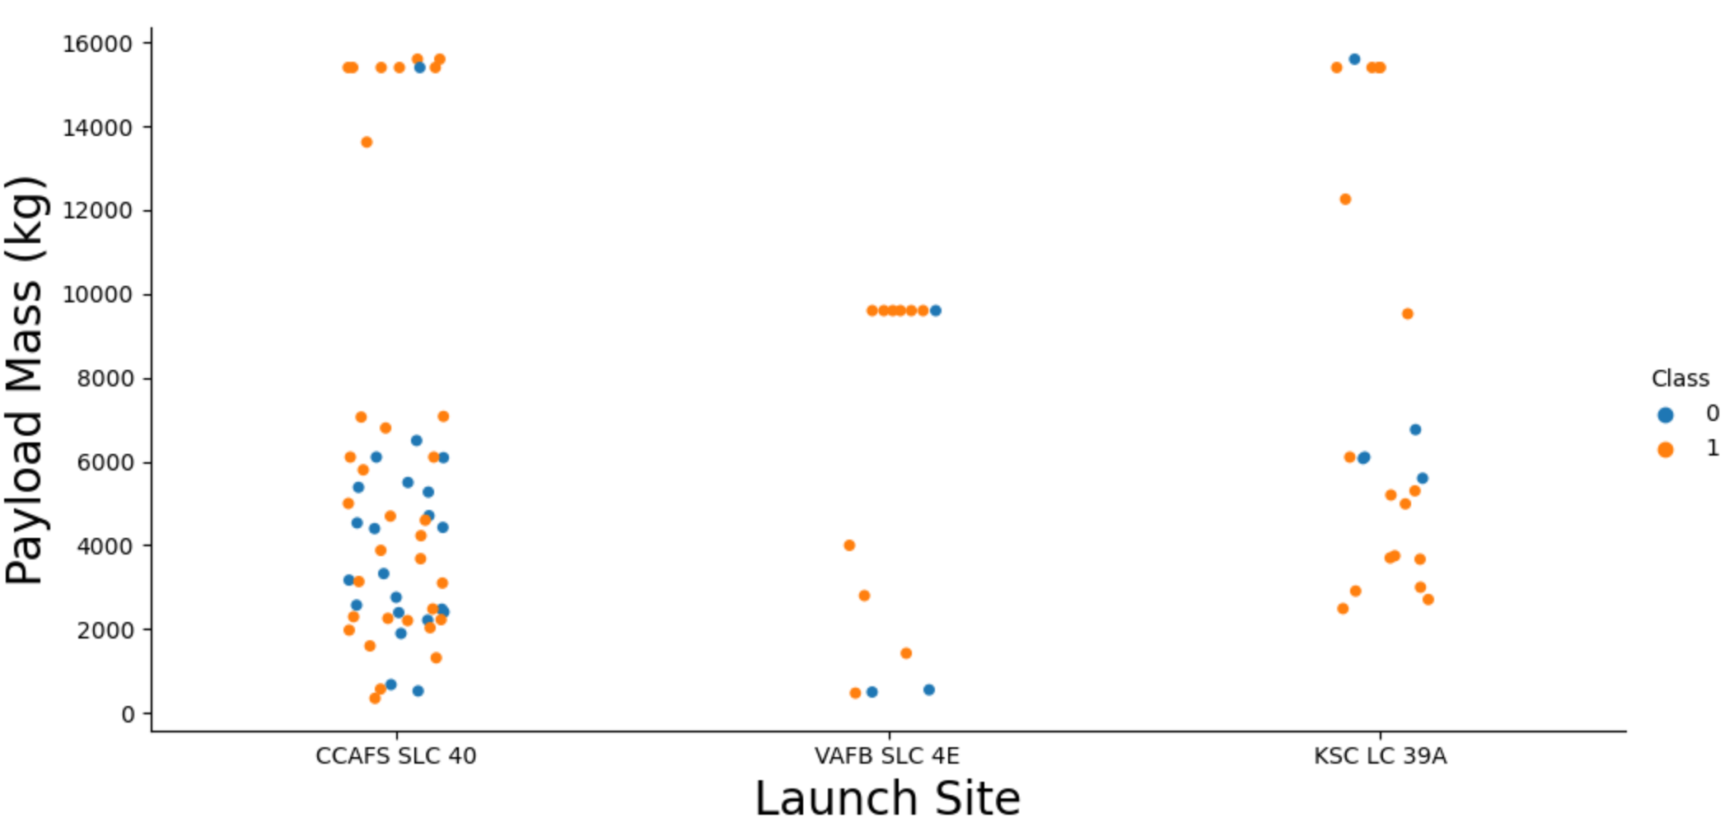
EDA with data visualization: Categorical & Scatter Plot
Link: EDA with Data Visualization Notebook on GitHub

Slide 13
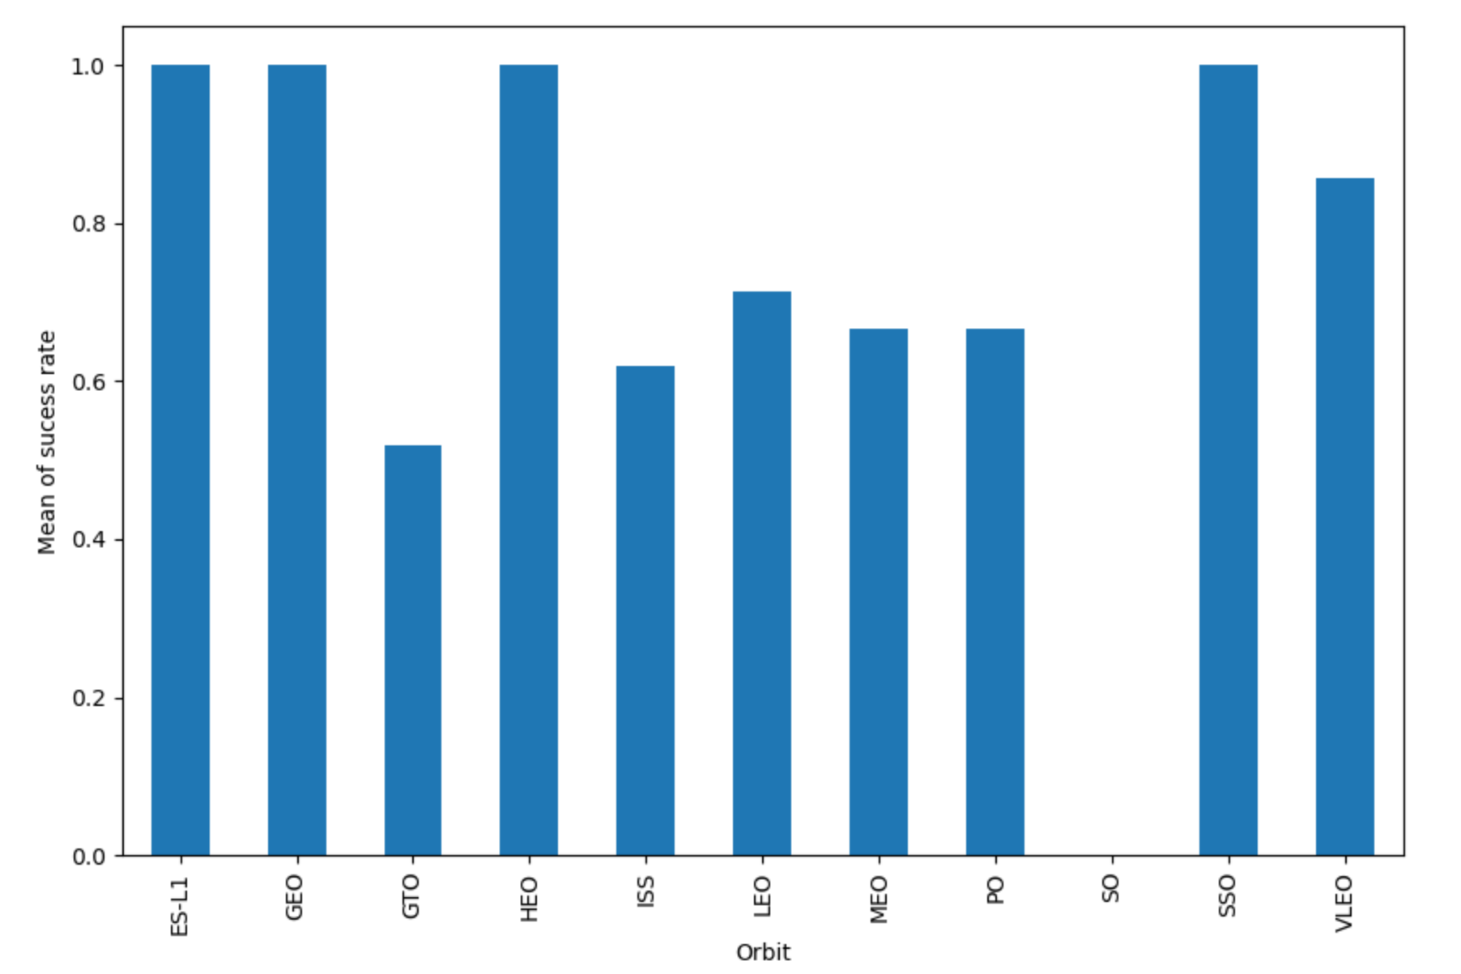
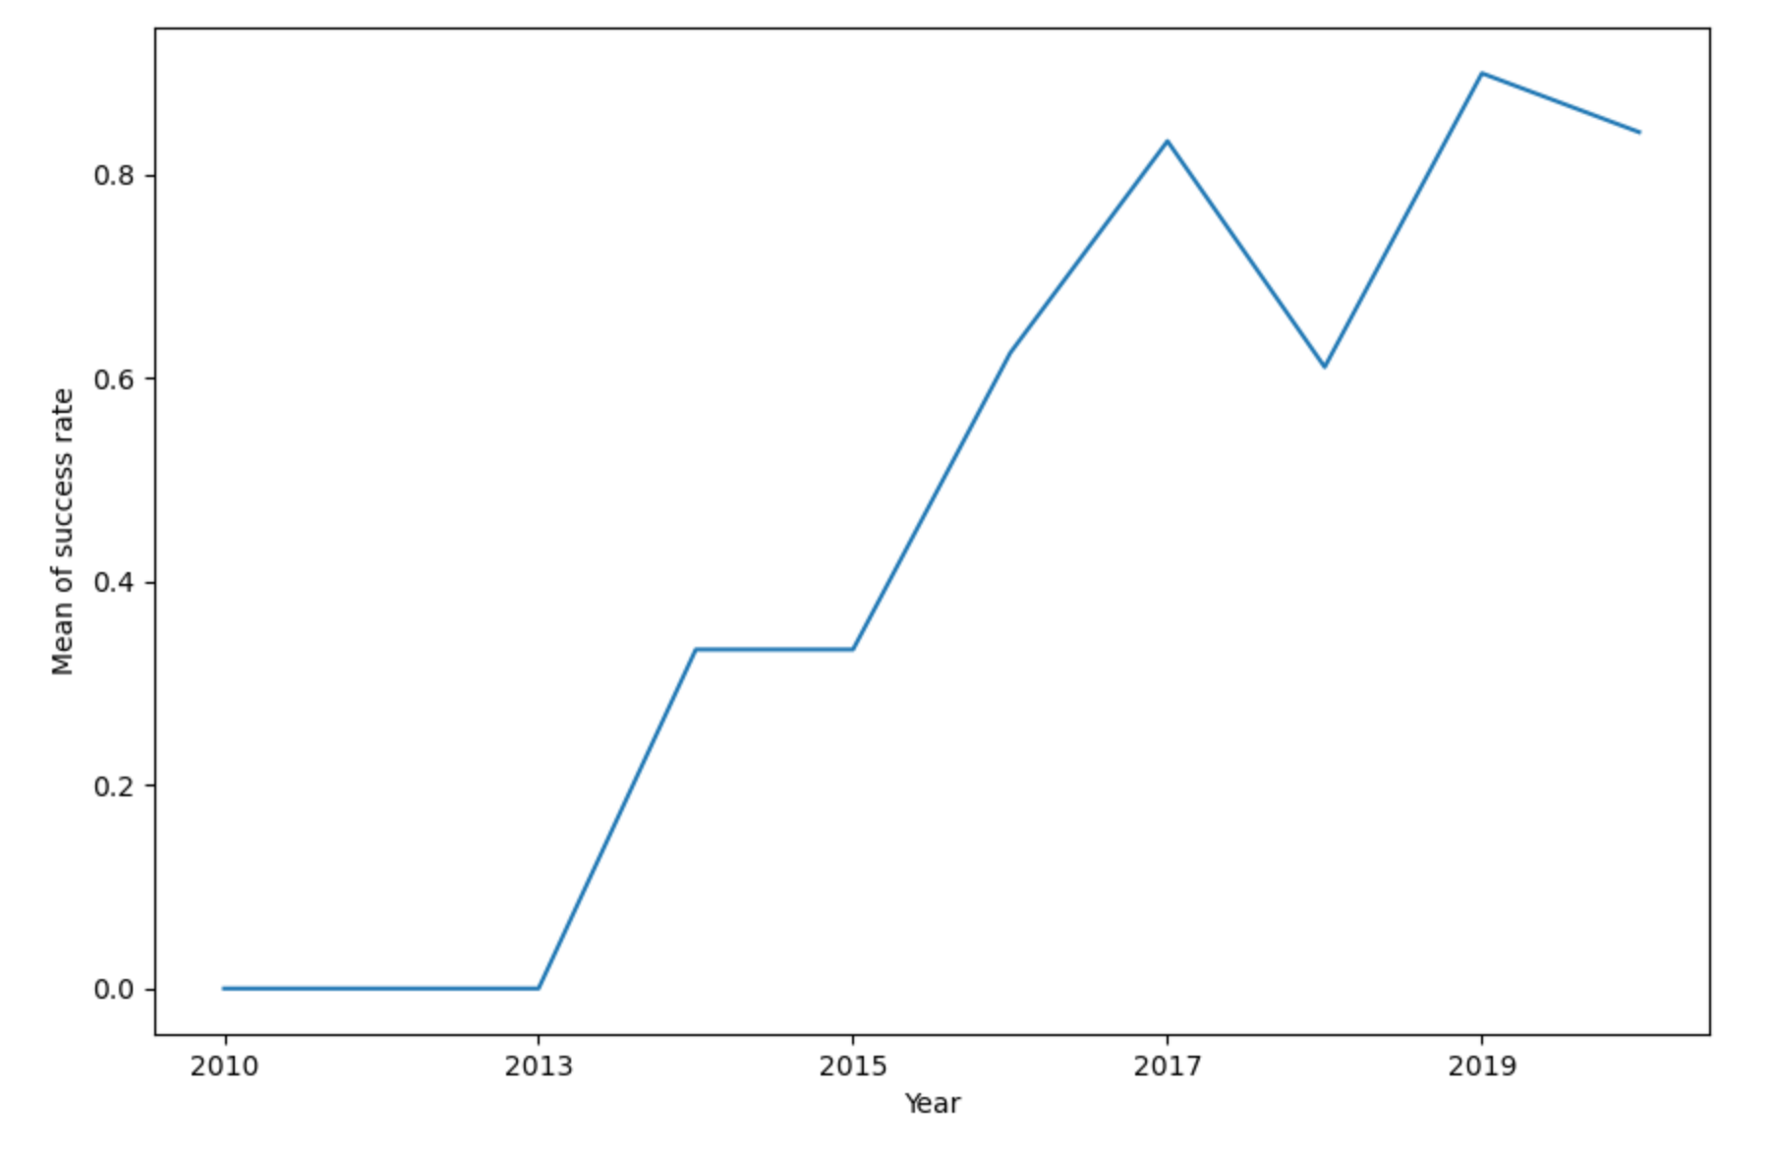
EDA with data visualization:
Bar Chart & line plot
Link: EDA with Data Visualization Notebook on GitHub

Slide 14
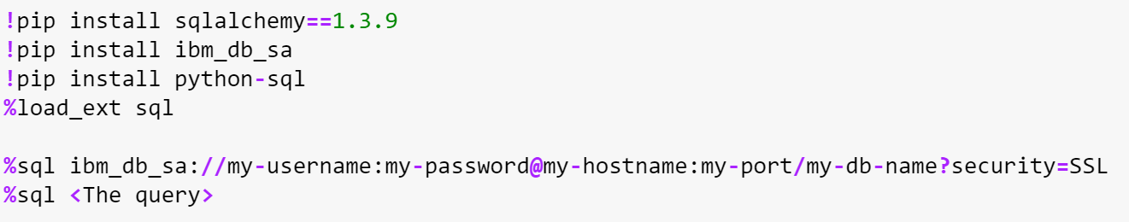
EDA with SQL
IBM’s Db2 was used for cloud, fully managing
SQL database provided as a service
The following SQL queries were used to gather info from the given database:
Displaying the names of the unique launch sites in the space mission
Displaying multiple records where launch sites begin with the string ‘CCA’
Displaying the total payload mass carried by boosters launched by NASA (CRS)
Displaying average payload mass carried by booster version F9 v1.1
Listing the date when the first successful landing outcome in ground pad was achieved
Listing the names of the boosters which have success in drone ship and have payload mass greater than 4000 but less than 6000
Listing the total number of successful and failure mission outcomes
Listing the names of the booster_versions which have carried the maximum payload mass (Using a subquery)
Listing the records which will display the month names, failure landing_outcomes in drone ship ,booster versions, launch_site for the months in year 2015.
Ranking the count of successful landing_outcomes between the date 04-06-2010 and 20-03-2017 in descending order
Link: EDA with SQL Notebook on GitHub

Slide 15
Building an interactive map with folium
Marked all past launch sites on the map, using folium.circle and folium.marker
Using the latitude and longitude coordinates of each site
Most of the launch sites were within a close distance of 1.5km from coastline
Marked the successful and failed launches for each site on the map
Easy to visualize the outcome of launches for each site with green and red markers
Draw a Polyline between SLC-40 launch site and its proximities
Added Folium MousePosition to get map coordinates for a mouse over a point on the map
Link: Interactive Visual Analytics with Folium Notebook on GitHub

Slide 16
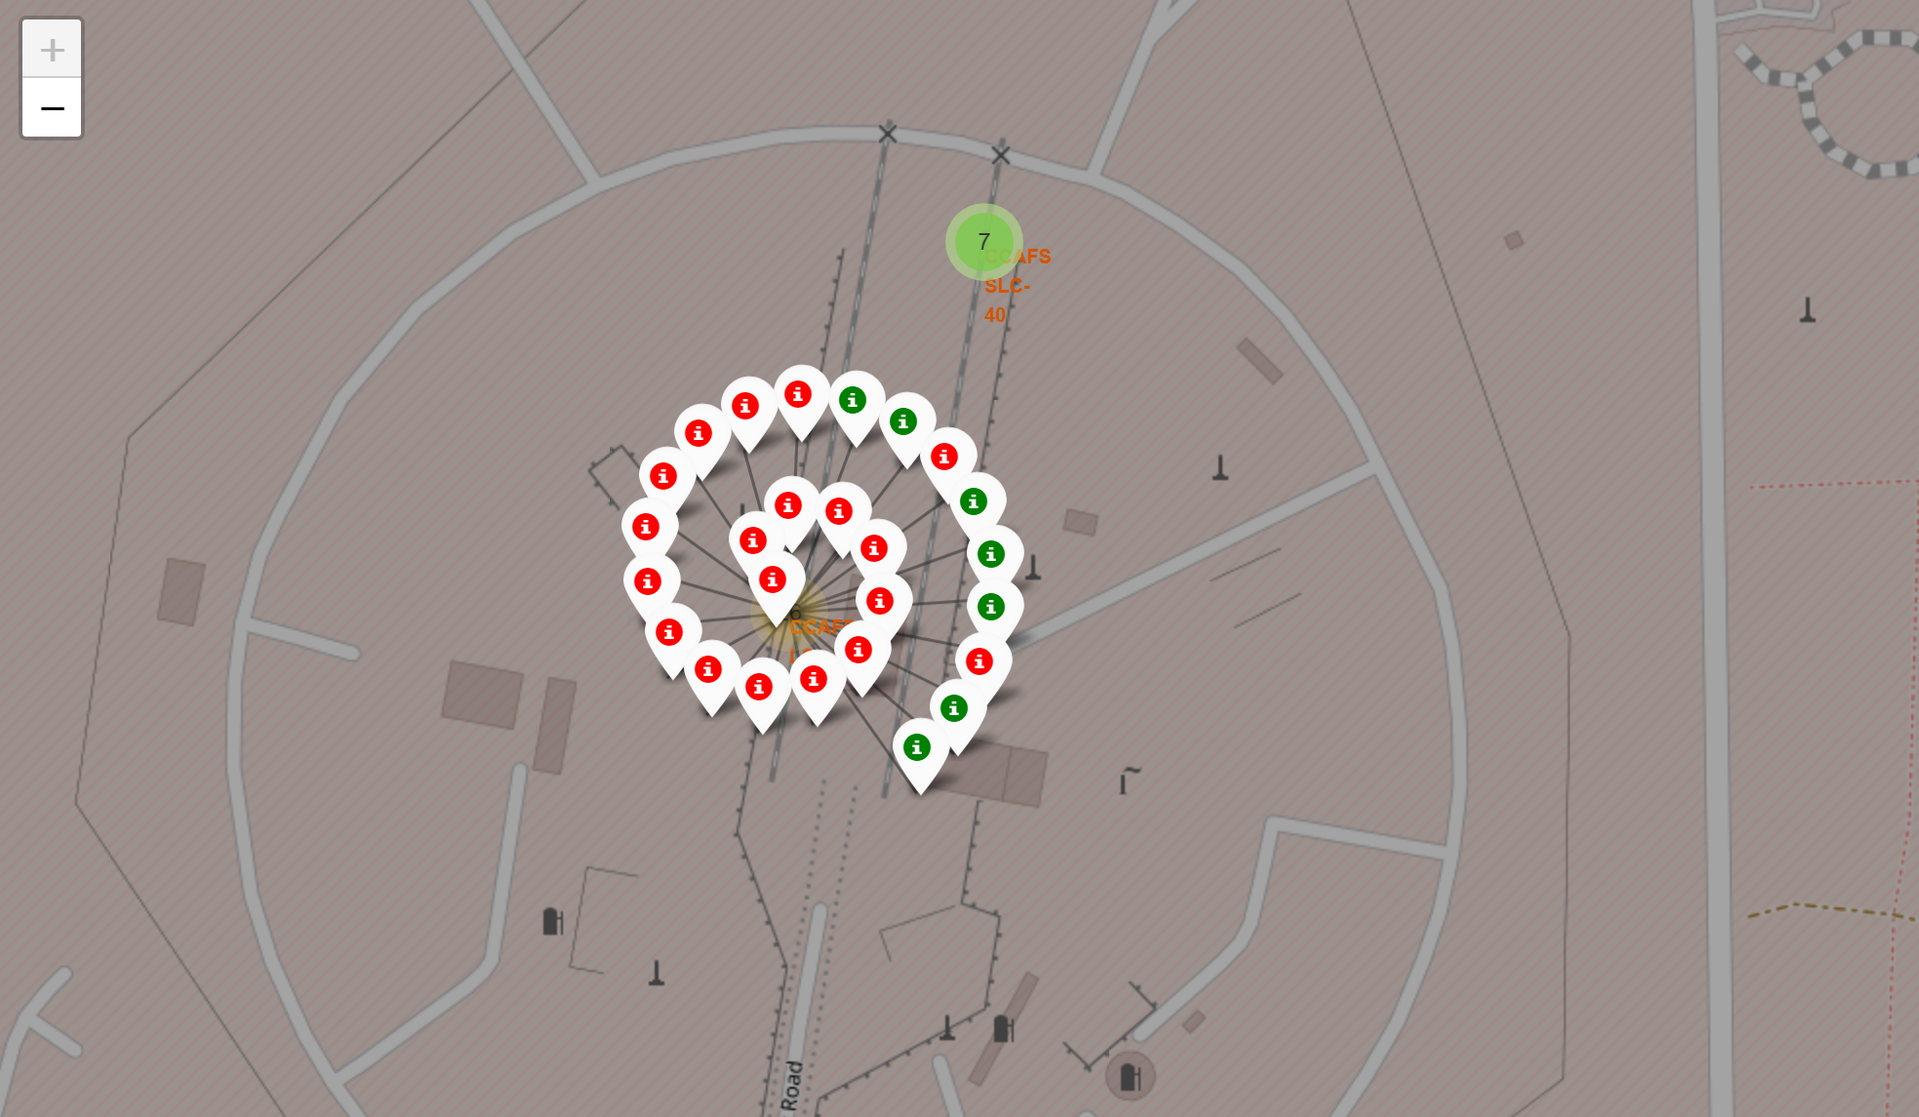
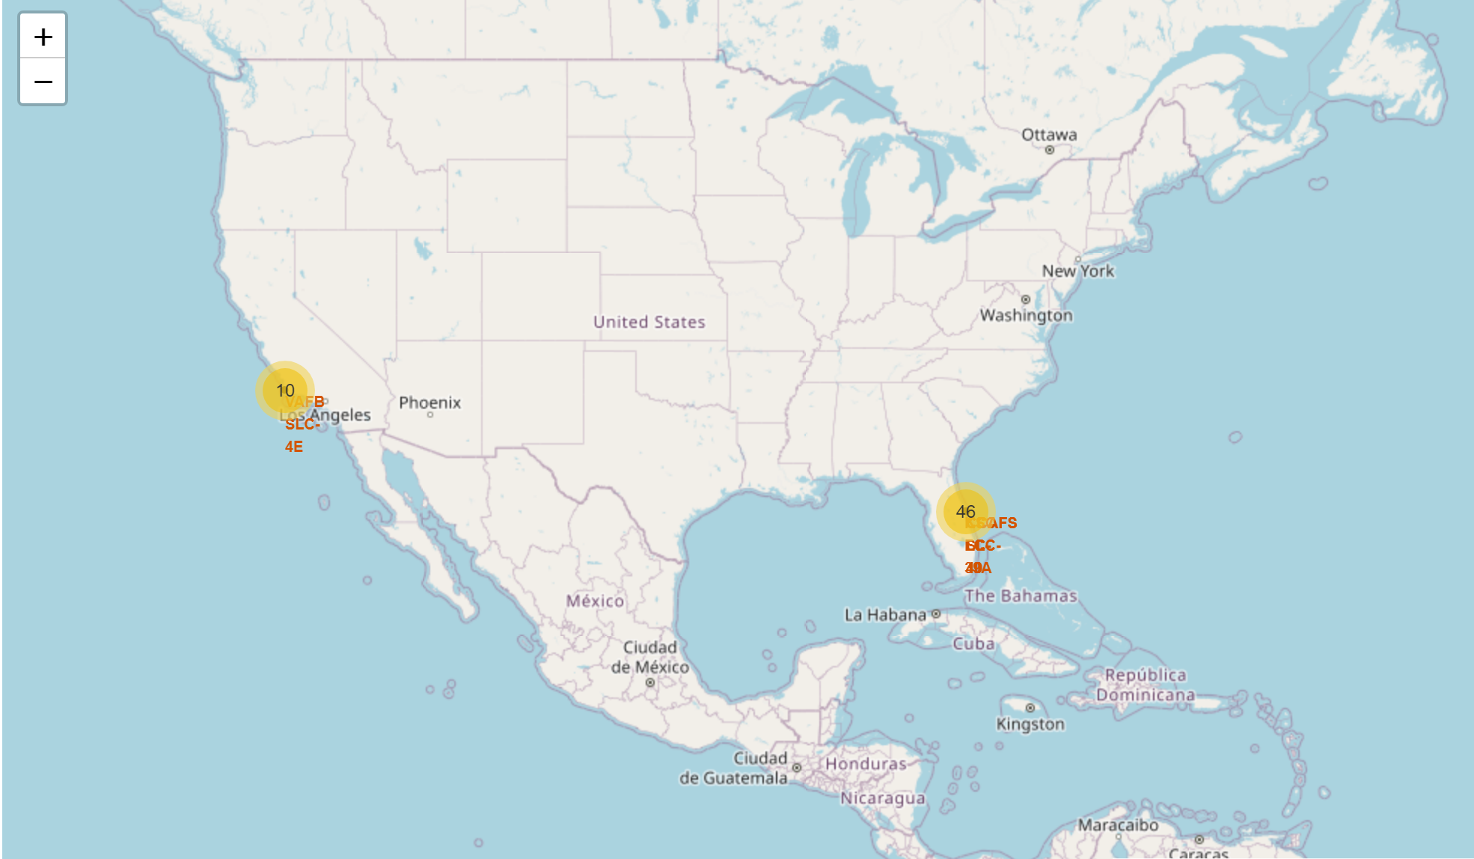
Building an interactive map with folium
Link: Interactive Visual Analytics with Folium Notebook on GitHub

Slide 17
Build a dashboard with
Plotly dash
The dashboard includes:
A pie chart showing the total success, for all sites or by certain launch site
A slider to allow for payload ranges to be highlighted
A scatter plot showing the correlation between payload and success, for all sites or by certain launch site
Link: Plotly Dash Python Code on GitHub

Slide 18
Predictive analysis (classification)
With the help of Scikit-learn, Primary Machine Learning library, predictive analysis was done through the following steps:
Loaded data using NumPy and Pandas, transformed the data, and split them into training and testing sets
Created a ML pipeline to predict if the 1st stage would land
Used GridSearchCV to find the best ML method for the predictions
Improved the model using feature engineering and algorithm tuning
Found the models with the highest prediction accuracy
Link: Machine Learning Prediction Notebook on GitHub

Slide 19
Predictive analysis (classification)
Create the input x and label y matrices
Standardize the data
Split data into training and testing sets
Create a GridSearchCV object
Fit the training and testing sets into GridSearchCV
Calculate the accuracy on the test data
Choose the most favorable model
Compare the prediction with the real labels
Link: Machine Learning Prediction Notebook on GitHub

Slide 20
Results
The SVM, KNN, Logistic Regression, and decision tree models all performed with an accuracy score of 83.3%
A clear positive progress in the landing outcomes since the year 2015
Low weighted payloads executed better than the heavier ones
The EDA shows that successful landing is correlated with flight number
All the launch tests are located close to the coastline as well as highways and railways
KSC LC 39A had the most successful launches out of all the sites
Orbit GEO, HEO, SSO, and ES L1 have the best success rate

Slide 21

Insights drawn from EDA (Exploratory Data Analysis)

Slide 22
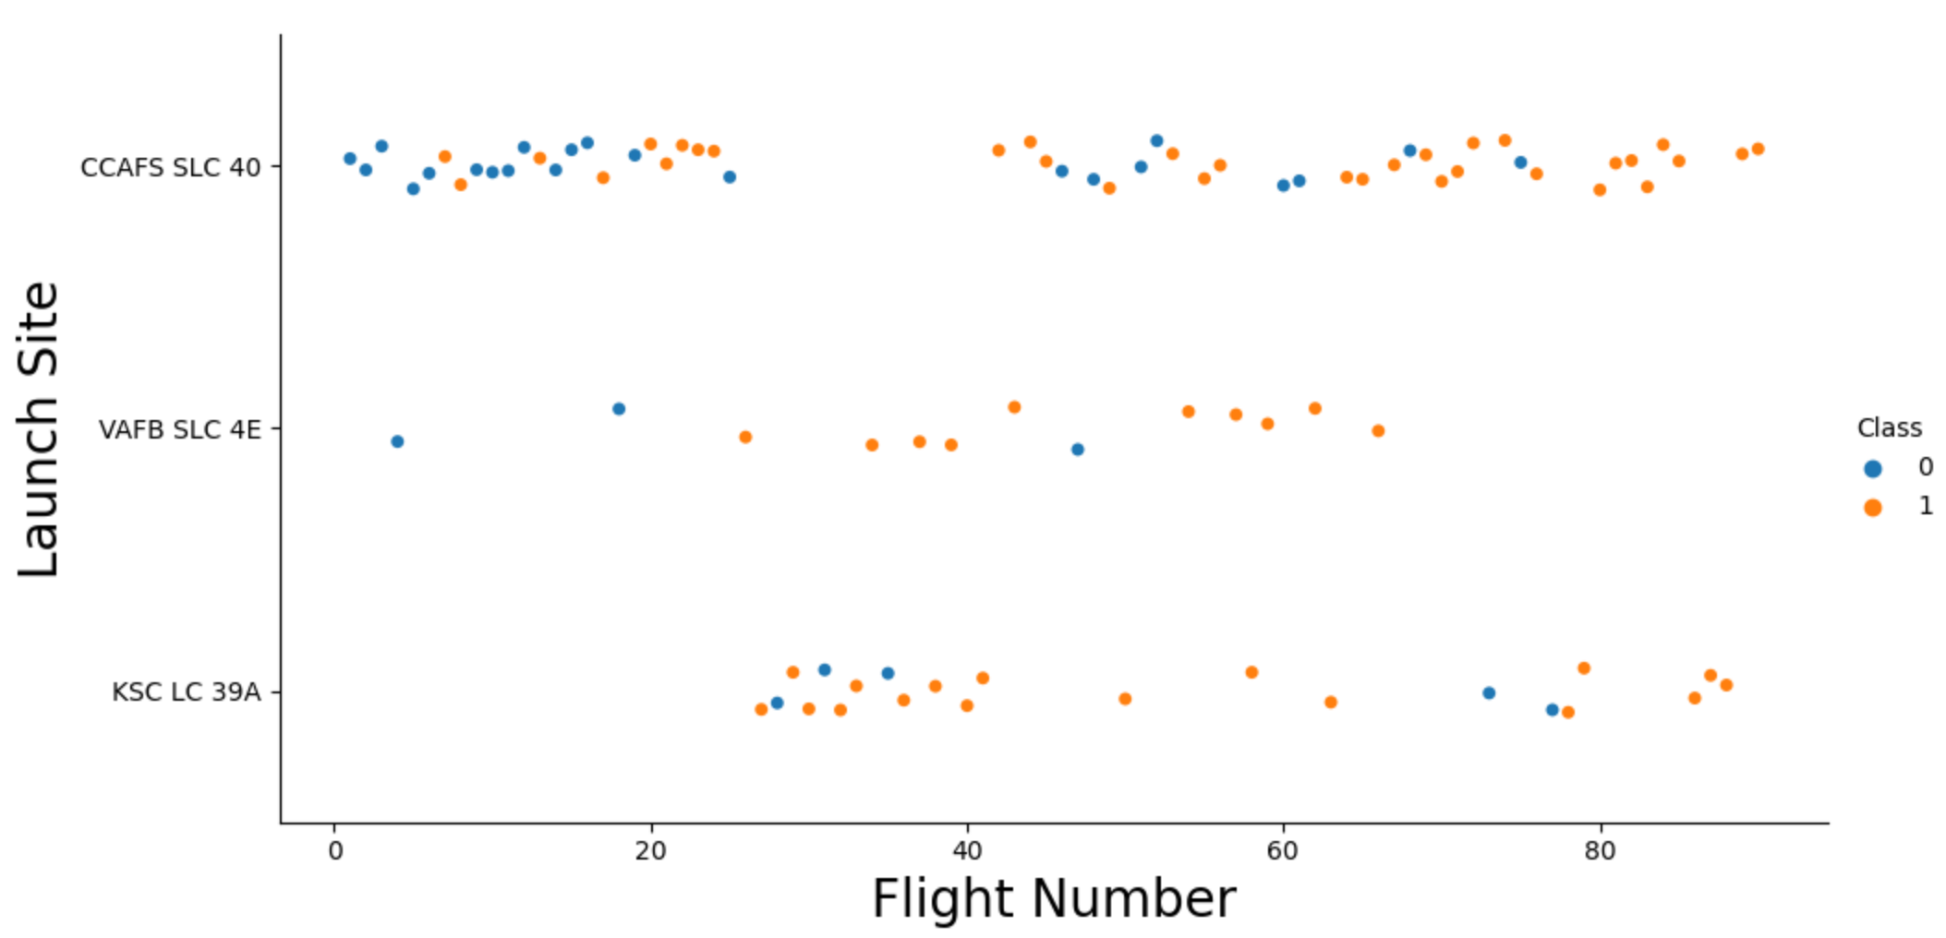
Flight number vs. launch site
CCAFS SLC 40 has the greatest number of launches. While VAFB SLC 4E had the least number of launches
With higher flight number, around 30 and greater, at each launch site the success rate increases

Slide 23

Payload mass vs. launch site
Most of the lower payloads mass launches have been from CCAFS SLC 40
VAFB SLC 4E site has no rocket launches for heavy payload mass (greater than 10000 kg)
Except for VAFB SLC 4E site, the greater the payload mass the higher the success rate for the rocket. Yet, there is no clear pattern.

Slide 24
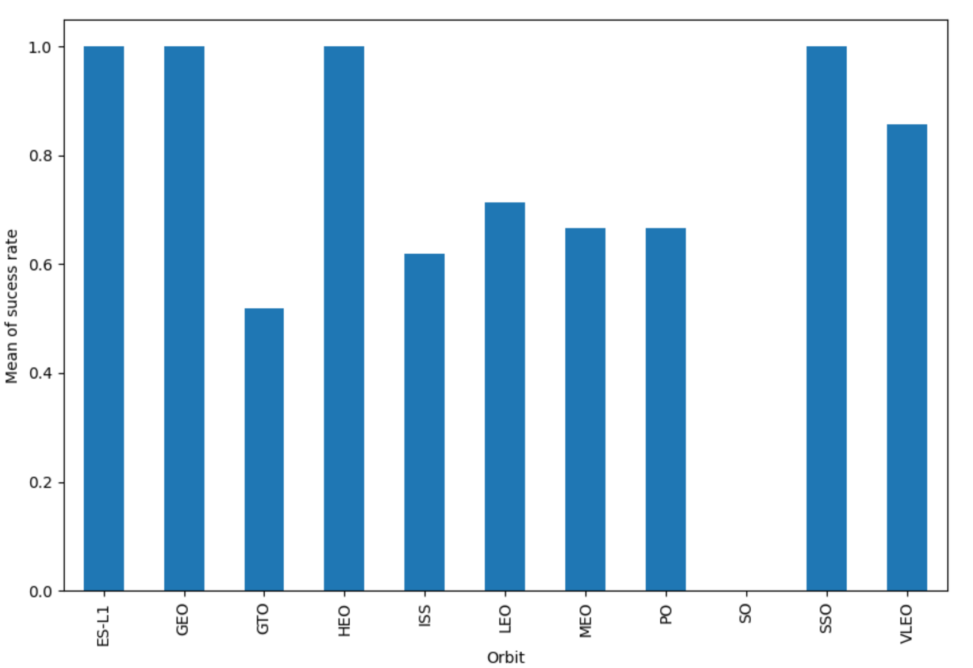
Success rate vs. orbit type
Orbit GEO, HEO, SSO, and ES L1 have the best success rate

Slide 25
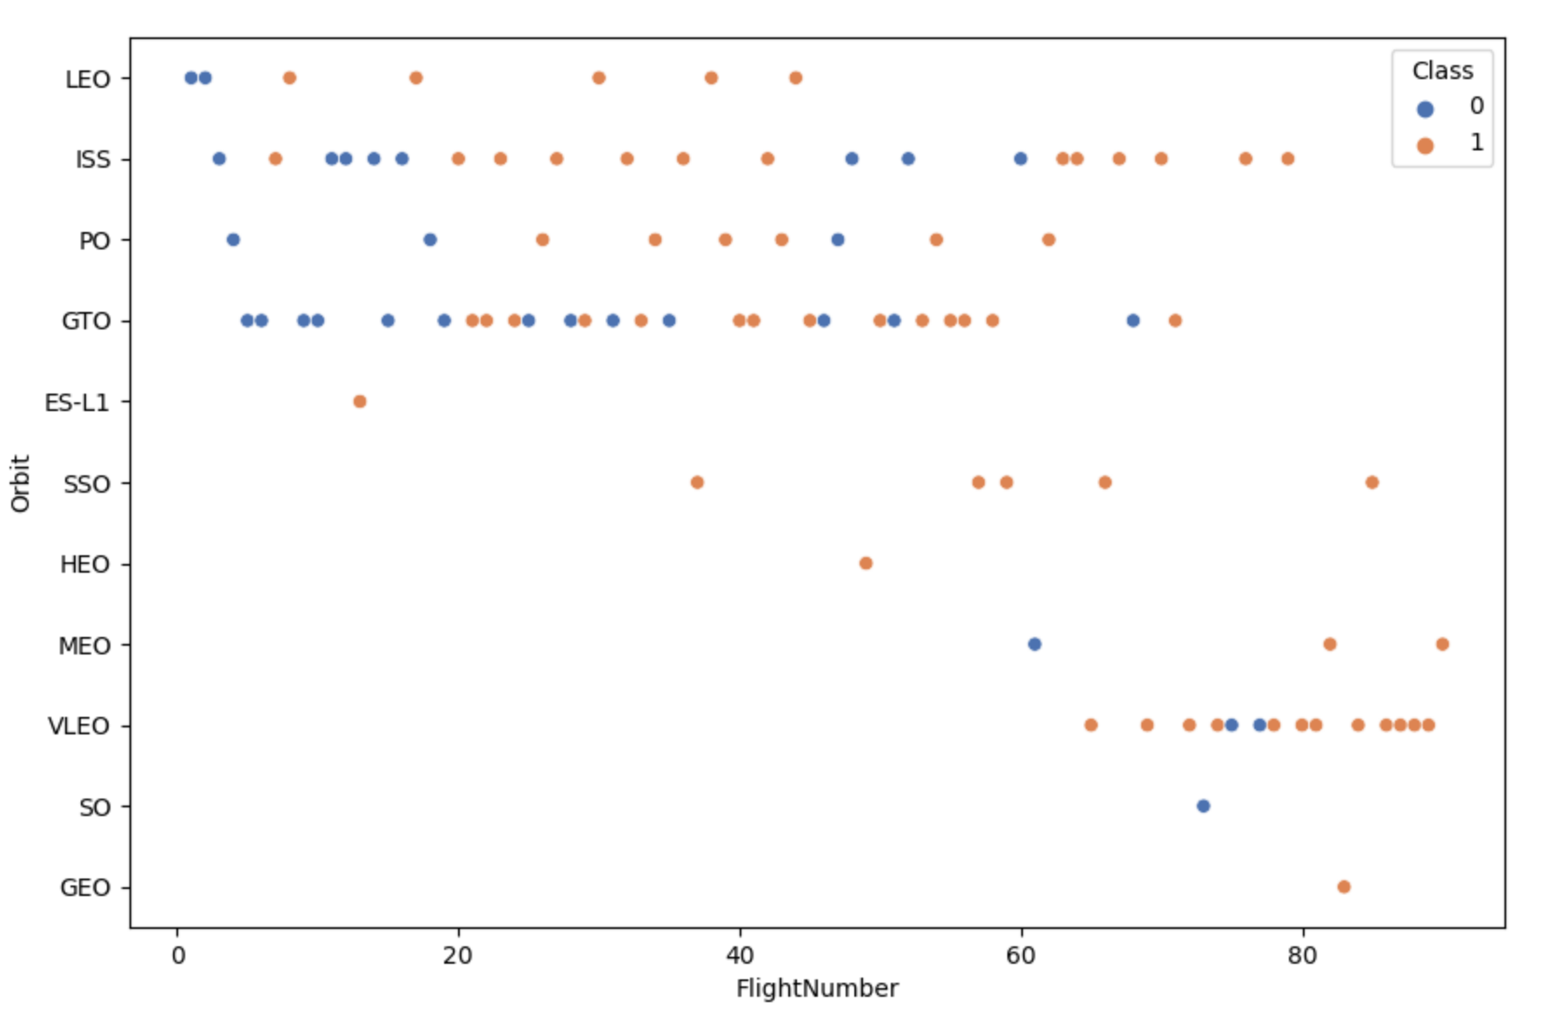
Flight number vs. orbit type
For orbit LEO and VLEO, the success rate increases with the number of flights
There seems to be no correlation between the 2 variables for orbit GTO and ISS
Orbit SSO seems to be very successful, yet the sample size is small

Slide 26
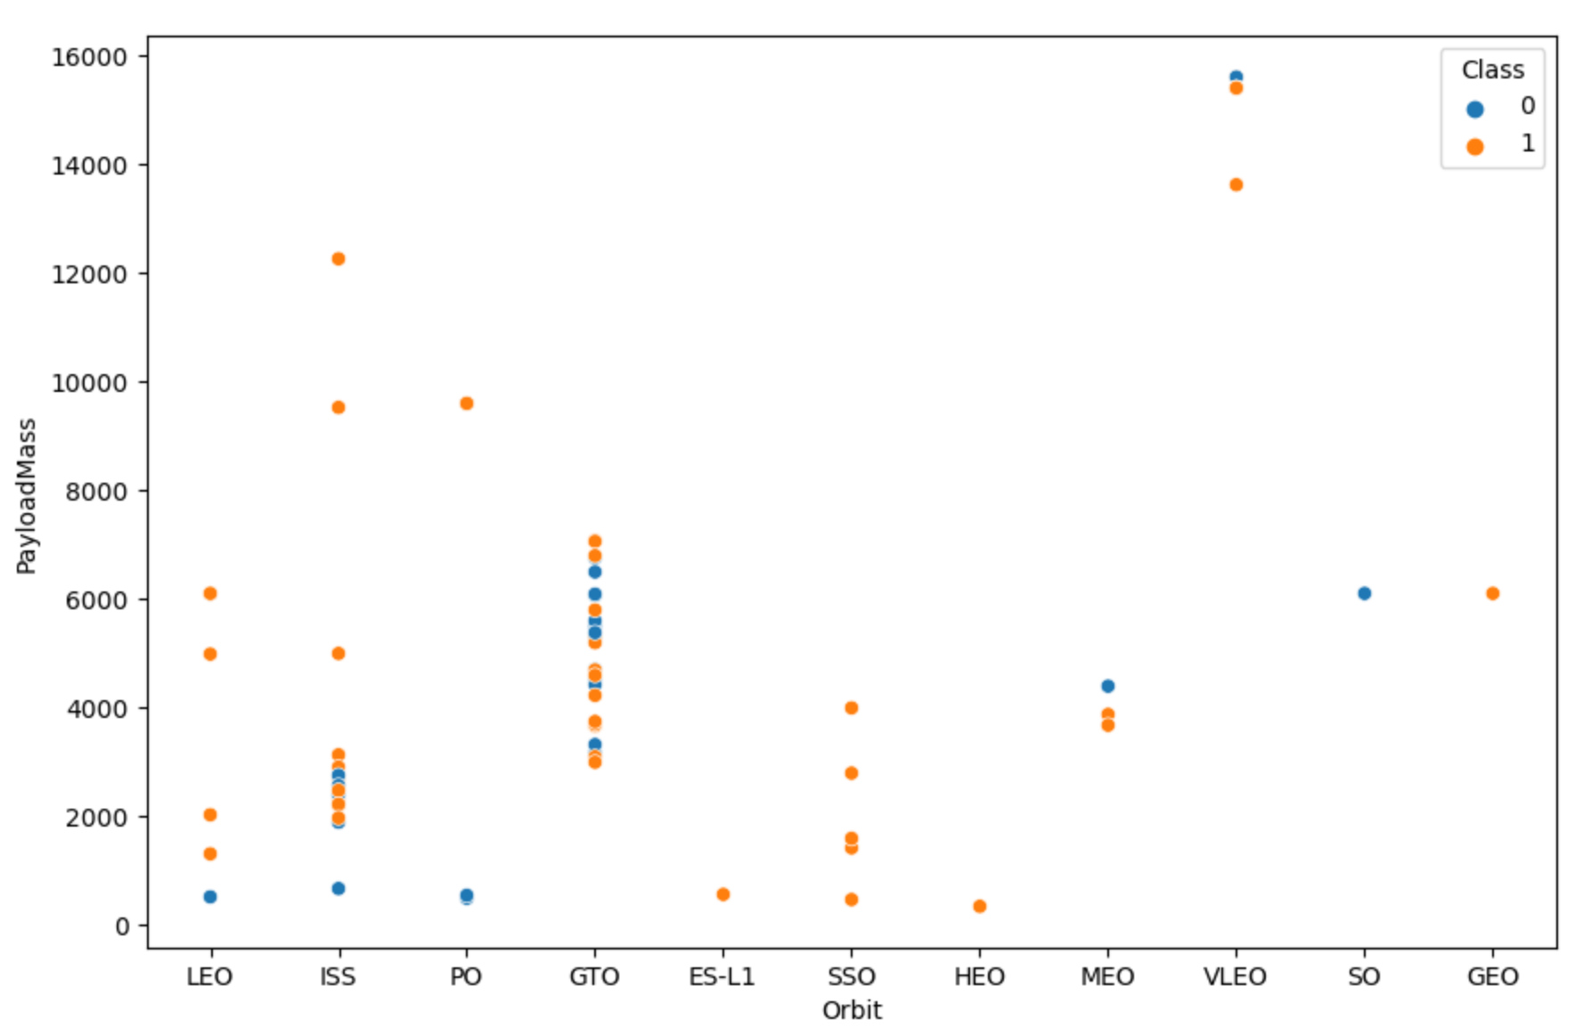
Payload mass vs. orbit type
For orbit LEO, PO, and ISS, the success rate increases as the payload mass gets heavier
There seems to be no correlation between the 2 variables for orbit GTO
Orbit MEO and VLEO were affected negatively by the heave payload masses

Slide 27
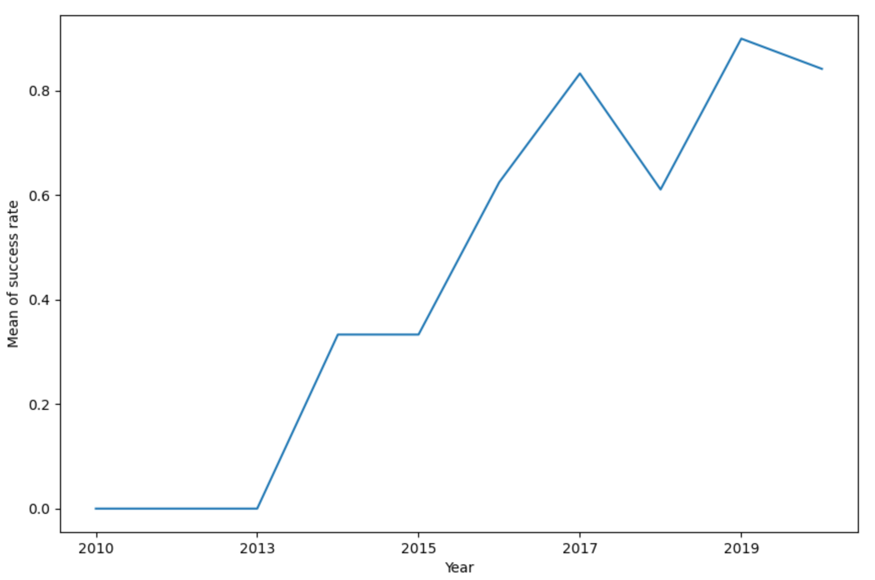
Launch success yearly trend
Launch success rate has increased significantly since 2013, though there is a slight dip after year 2019

Slide 28

EDA with SQL

Slide 29
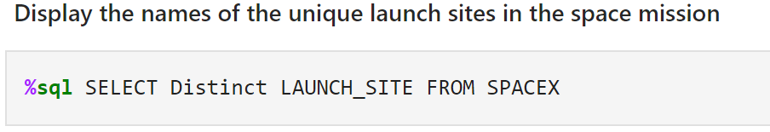
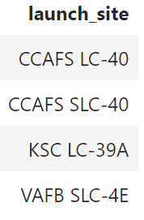
All launch site names
Keyword DISTINCT show only unique launches sites from the dataset

Slide 30
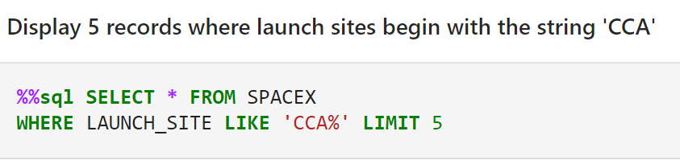
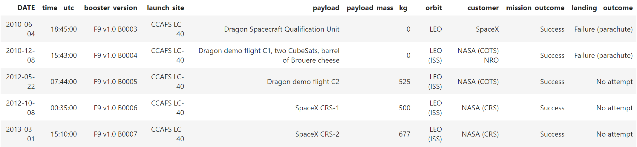
launch site names begin with ‘cca’
Condition keyword LIKE with the percentage sign in ‘CCA%’, indicating the name must start with CCA
Keyword LIMIT 5 fetch 5 records from the table

Slide 31
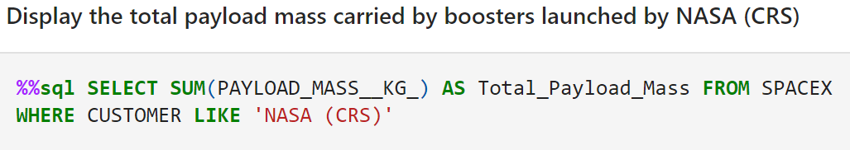
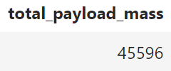
All launch site names
Function SUM calculates total in the column it is used in
WHERE clause filters the data to fetch customers by name ‘NASA (CRS)’

Slide 32
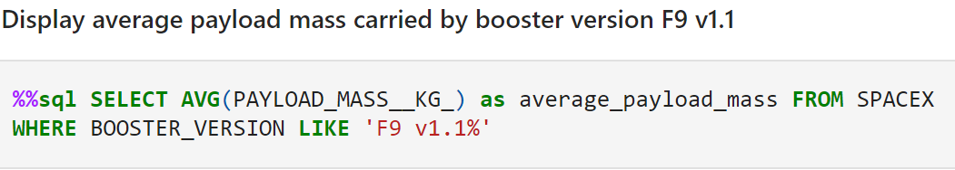
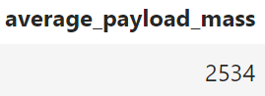
Average payload mass by
F9 v1.1
Function AVG calculates the average of the column it is used in

Slide 33
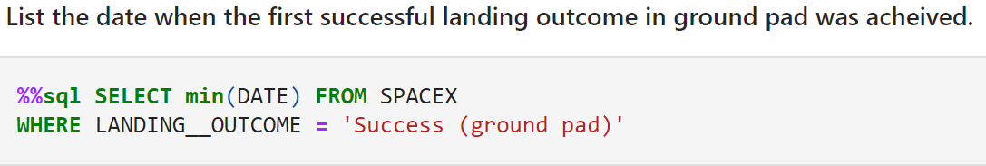
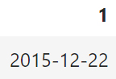
First successful ground landing date
Function MIN works out the minimum value in the column it is used in

Slide 34
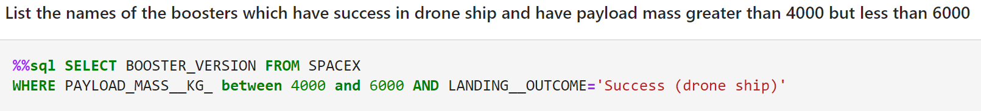
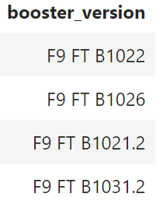
Successful drone ship landing with payload between 4000 & 6000
AND logical operator specifies additional filter conditions

Slide 35
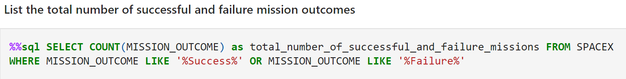
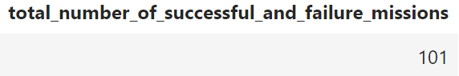
Total number of successful and failure mission outcomes
Function COUNT returns the number of values in the column it is used in
Condition keyword LIKE was used twice, one time for each condition of success and failure

Slide 36
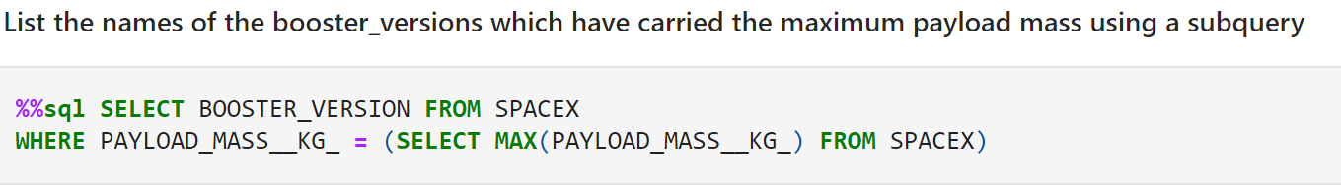
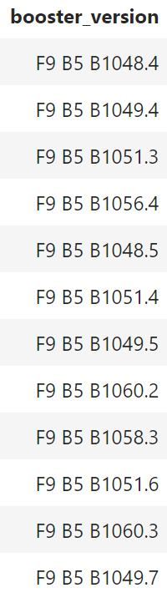
Boosters carried maximum payload
A query that appears inside another query is called a Subquery, which was used here

Slide 37

Interactive maps
With folium

Slide 38
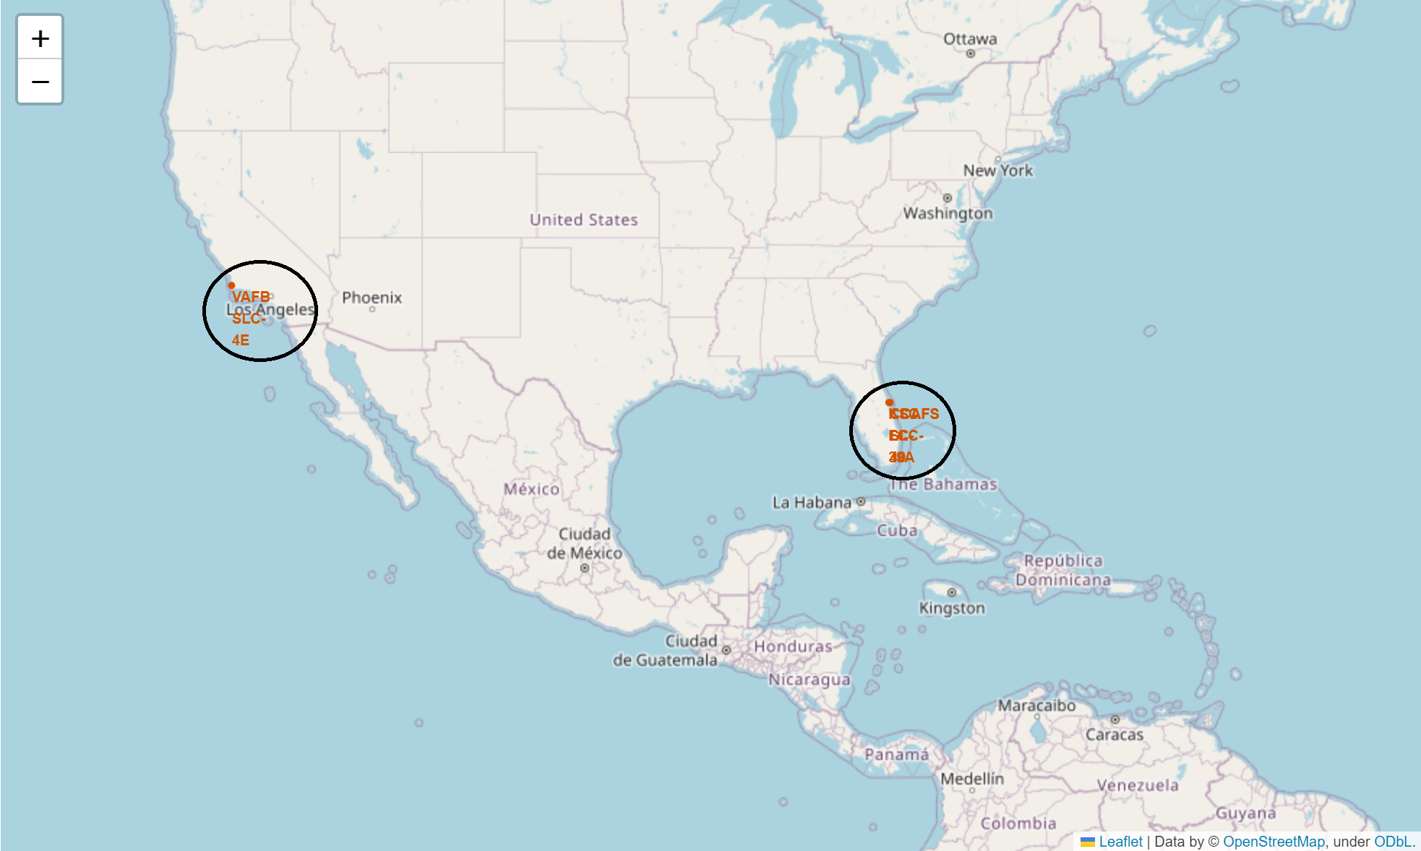
Launch site locations
SpaceX launch sites are near the equator line and U.S.A coasts
(Florida & California)

Slide 39
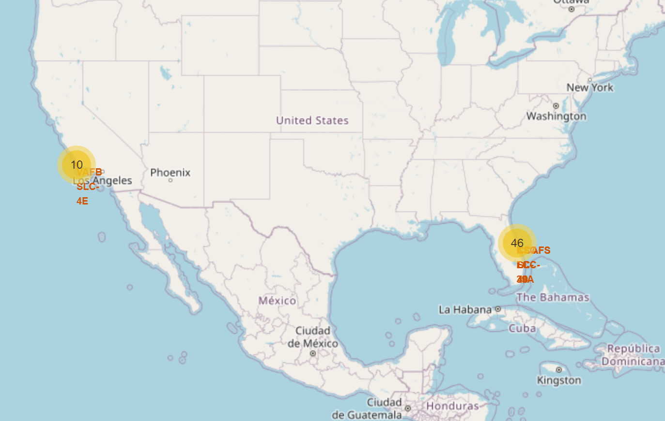
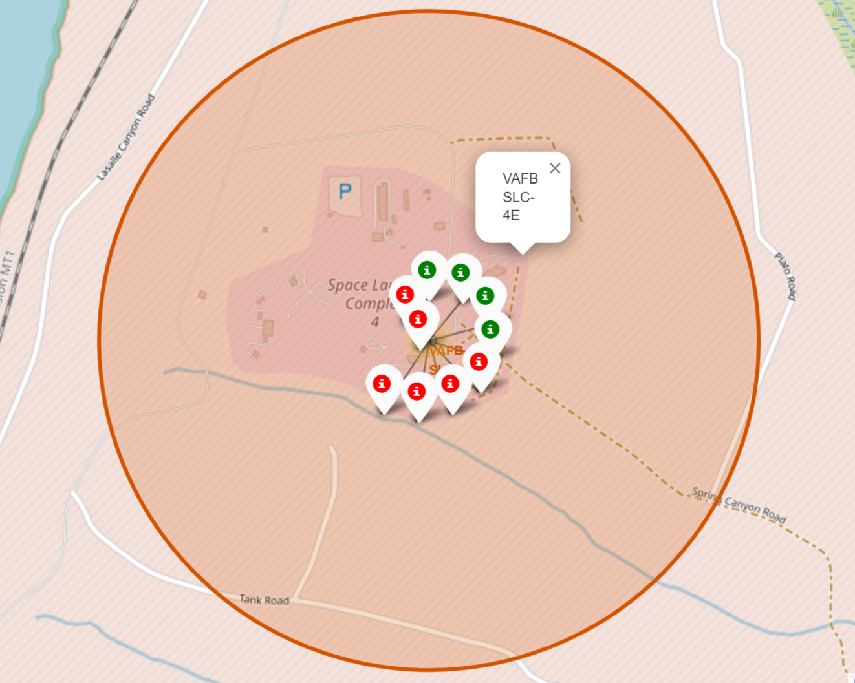
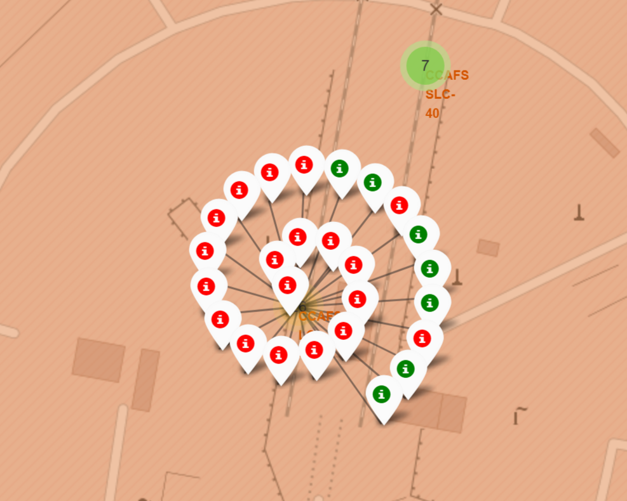
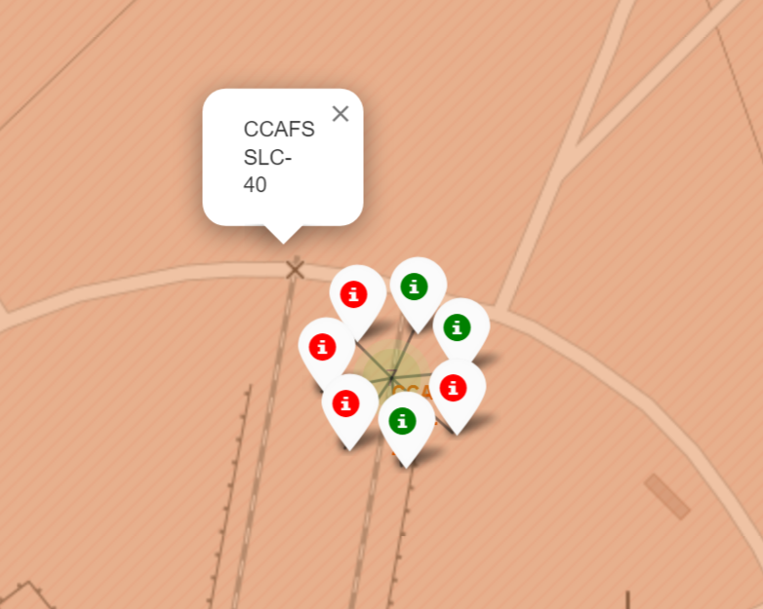
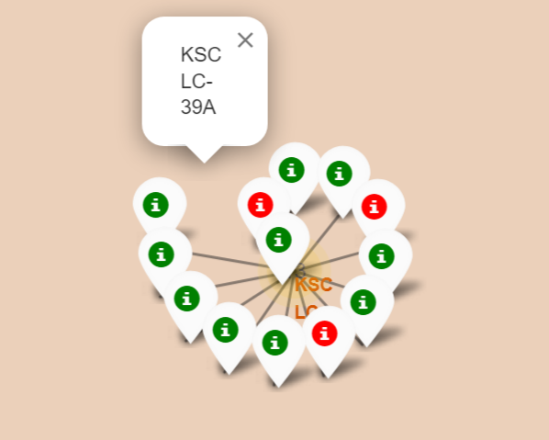
Success rate of rocket launches (Color labeled)
Green markers show successful launches, while red markers show failures
KSC LC-39A has the highest success rate of rocket launches
VAFB SLC-4E
CCAFS LC-40
CCAFS SLC-40
KSC LC-39A

Slide 40
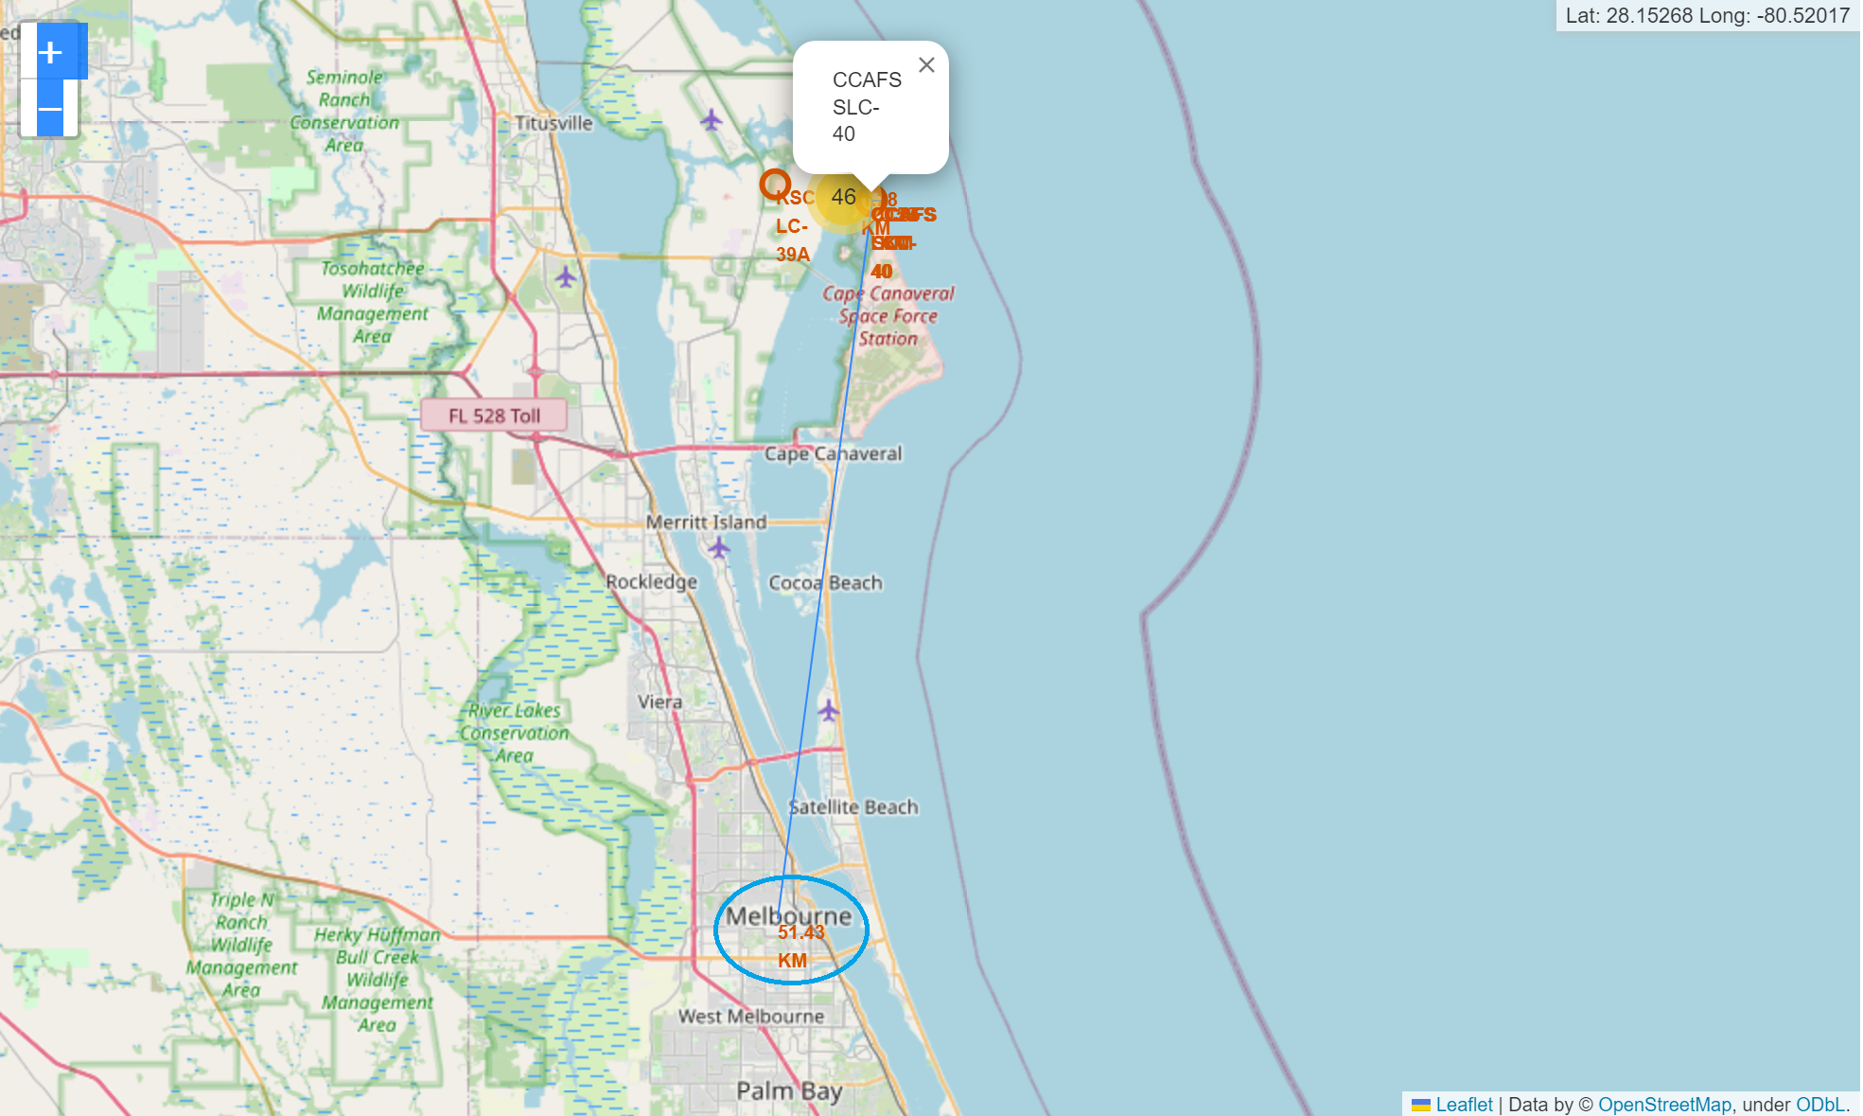
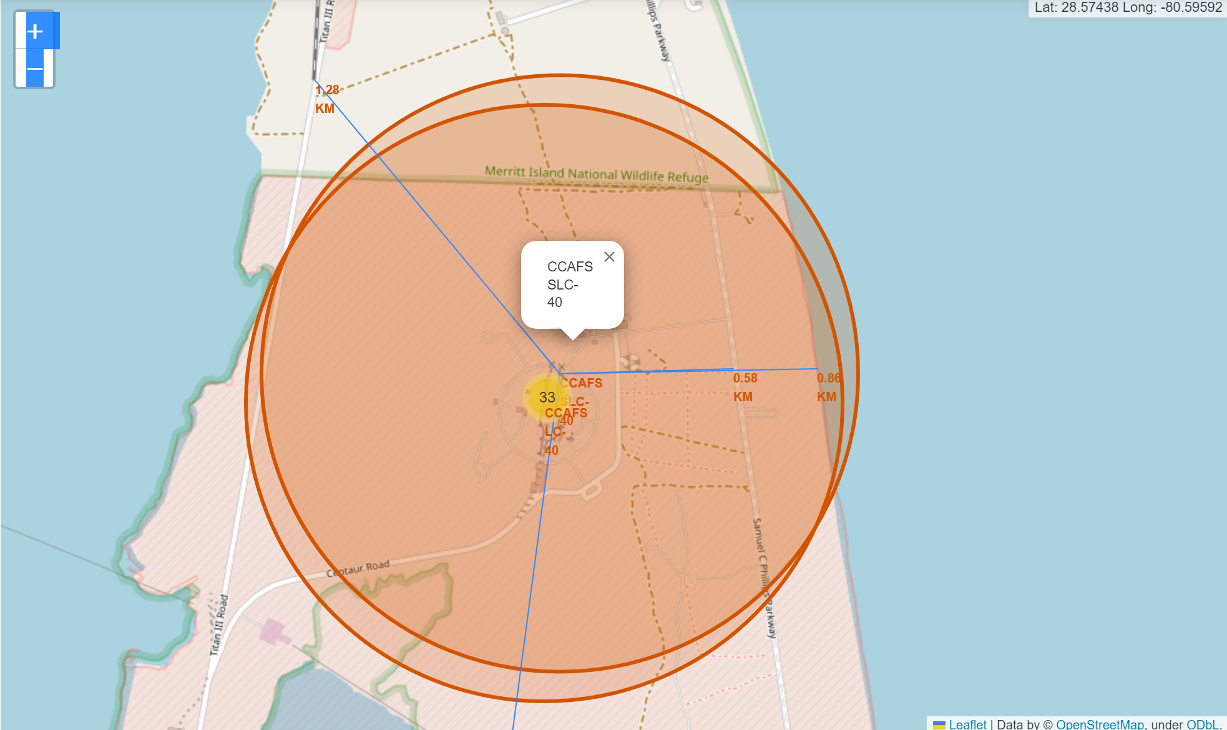
Launch site distance to landmarks
Taking site CCAFS SLC-40 as an example, it is over 50KM far from the nearest city, Melbourne
The site is less than 1KM far from coastline, which helps with the rocket landing on water bodies
The site is less than 1KM highway, and a bit over 1KM far from the nearest railway. Thus, providing convenient transportation required for launches

Slide 41

Build a dashboard with plotly dash

Slide 42


Total success launches by
all sites
Site KSC LC-39A has the highest success rate of all sites

Slide 43


Total success launches by
all sites
Low weighted payload (0kg – 4000kg)
High weighted payload (4000kg – 10000kg)
Success rate for low weighted payloads is better than the heave weighted
Payload range between 2000kg and 4000kg has the highest success rate

Slide 44

Predictive analysis
(classification)

Slide 45


Classification accuracy
All the models have performed with the same accuracy
Decision tree model was selected for the classification

Slide 46


Confusion matrix
All the models have the same confusion matrix
The model failed to predict 3 labels

Slide 47
Conclusions
For successful rocket launches of SpaceY, we compared and analyzed the data of the competitor SpaceX. The following crucial points were found:
All launch sites are close to the coasts, highways and railways. And away from cities
The landing success increased with flight number
Year 2015 onwards, the success rate of rocket launches improved significantly
Site KSC LC-39A has the highest launch success rate
Orbits ES-L1, GEO, HEO, SSO, VLEO has the highest success rate
Low weighted payloads (less than 4000kg) performed better than the heavier payloads
The data was used to train a Machine Learning model to predict landing outcome with 83.3% accuracy. This helps saving SpaceY money by reusing the first stage of the rockets.

Slide 48
THANK YOU

